Slide 1

Force control in hydraulic cylinders
with variable impedance
PhD Student:
Job Ledezma
Supervisors:
Claudio Semini
Victor Barasuol
Genova, Italy – February 2016

Slide 2
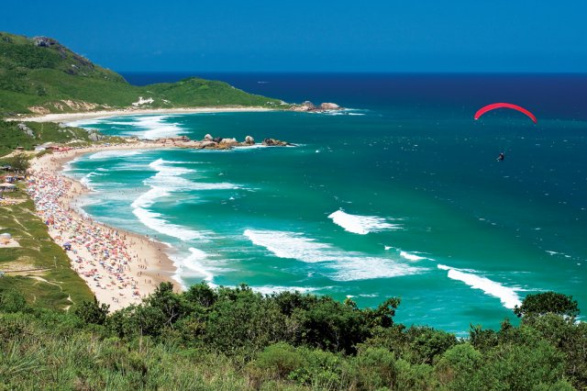
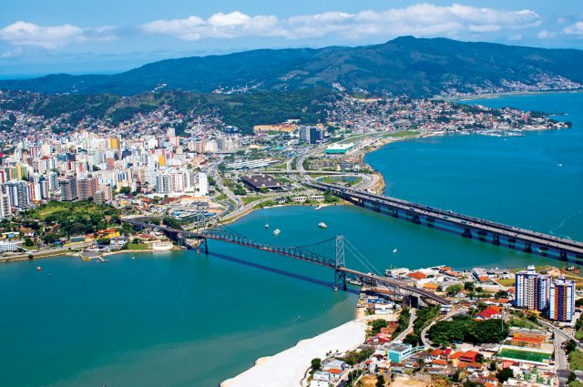

Introduction
Florianópolis is the capital city and second largest city of the state of Santa Catarina, in the South of Brazil. It is composed of one main island, a continental part and the surrounding small islands.
The city is known for having a very high quality of life, ranked as the country's third highest Human Development Index score among all Brazilian cities.

Slide 3
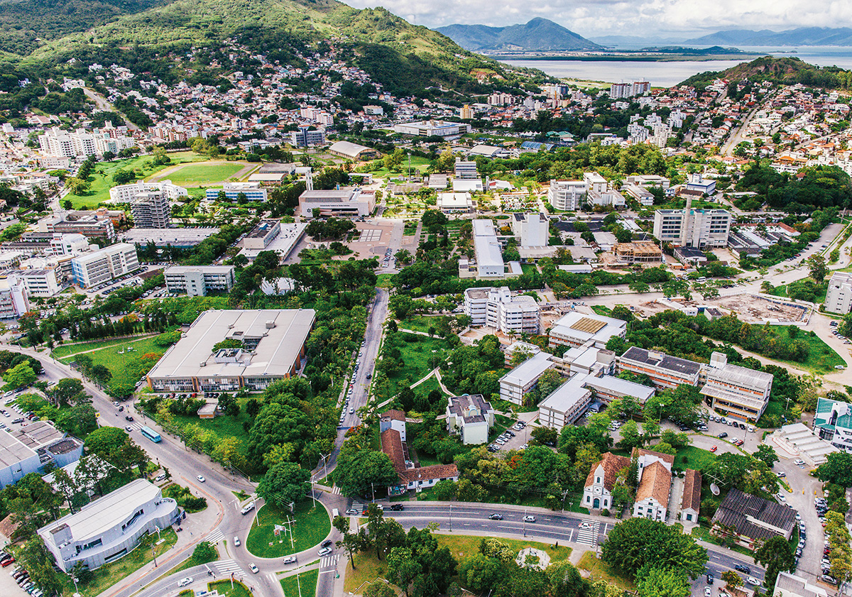
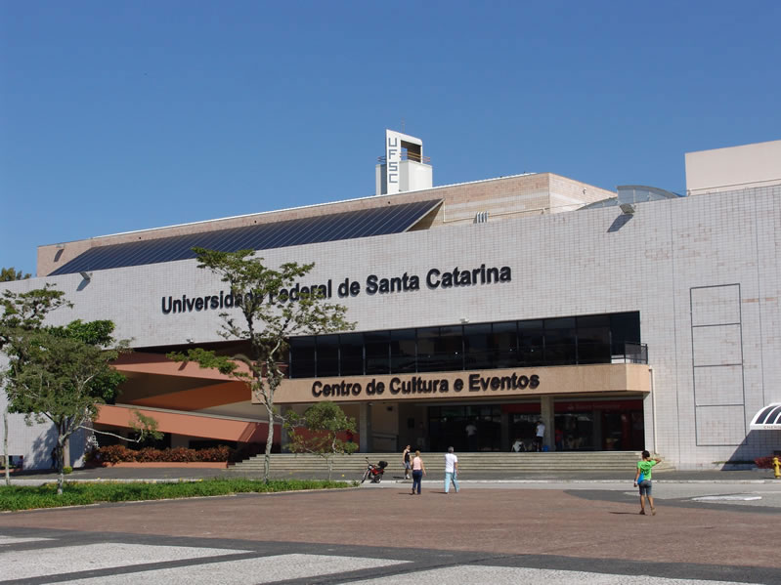

Introduction
The Federal University of Santa Catarina (UFSC) is a public university in Florianópolis, the capital city of Santa Catarina. It is one of the leading Brazilian and Latin American research universities, mainly noted for its engineering school.
It campus is divided in 11 Educational Centers, which are divided in departments. The largest one is the Department of Mechanical Engineering. The oldest is the Center of Juridic Sciences, that is itself the department of Law, which was the first of UFSC's departments to be officially recognized in 1932.

Slide 4

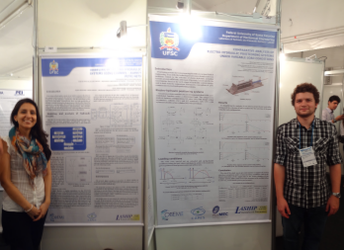
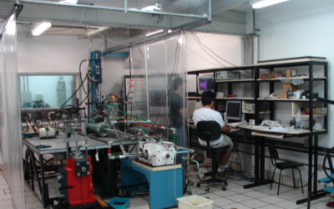
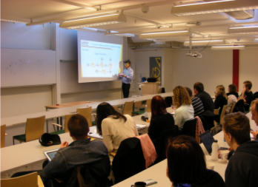
Introduction
LASHIP – Laboratory of Hydraulic and Pneumatic Systems of the Department of Mechanical Engineering at the Federal University of Santa Catarina has a structure focused on attending university activities of education, research and services.
The LASHIP’s team is involved with undergraduate education since 1977 and graduate education and research on hydraulic and pneumatic components and systems since 1984.

Slide 5
Introduction
The research funds are from government projects and partnerships with industries. Besides the infrastructure in equipment and facilities, it is established a group made by 3 professors and about 15 people among research engineers and graduate and undergraduate students connected through institutional projects and industry.
Research areas:
1 – Analysis and Design of Hydraulic and Pneumatic Systems and Components;
2 – Integration of Hydraulics and Pneumatics with software and electronics: Mechatronic Solutions;
3 – Computational systems to support the design of hydraulic systems and components

Slide 6
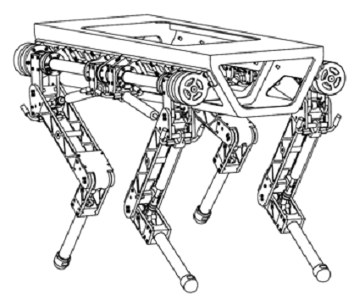
Thesis
Semini (2010):
HyQ - Design and Development of a Hydraulically Actuated Quadruped Robot
Development of a versatile robot platform capable of performing different dynamic tasks.
Study and test of the applicability of hydraulic actuation system inside the HyQ robot.
Design project and components selection procedures.
3D model of the HyQ
(Semini, 2010).

Slide 7
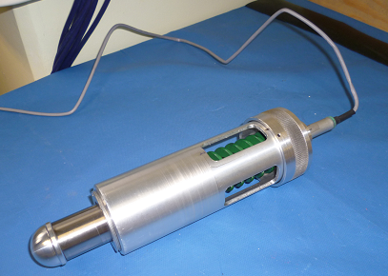
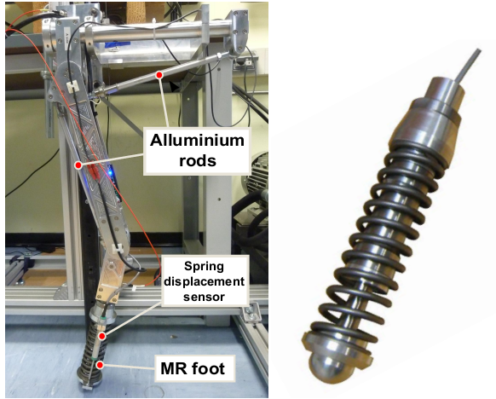
Thesis
Focchi (2013):
Strategies To Improve the Impedance Control Performance of a Quadruped Robot
Propose a procedure to select the minimum amount of stiffness at the foot in order to reduce the peak forces produced by ground contacts.
The selection of the passive element is based on the robot’s locomotion requirements.
Addition of an actively-controlled damper to dissipate the energy stored in the spring after its compression, reducing the chance of chattering when impact forces occur.

Slide 8
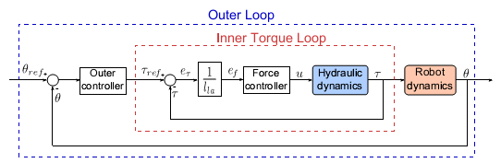
Thesis
Boaventura (2013):
Hydraulic Compliance Control of the Quadruped Robot HyQ
Propose a compliance control scheme of the HyQ robot.
This active compliance control allow the legs of the HyQ to emulate different types of springs and even nonlinear spring-dampers.

Slide 9
Articles & books
[1] M. H. Raibert, Legged robots that balance: MIT press, 1986.
[2] R. Blickhan, "The spring-mass model for running and hopping," Journal of biomechanics, vol. 22, pp. 1217-1227, 1989.
[3] R. M. Alexander, "Three uses for springs in legged locomotion," The International Journal of Robotics Research, vol. 9, pp. 53-61, 1990.
[4] D. P. Ferris, M. Louie, and C. T. Farley, "Running in the real world: adjusting leg stiffness for different surfaces," Proceedings of the Royal Society of London B: Biological Sciences, vol. 265, pp. 989-994, 1998.
[5] B. Siciliano and O. Khatib, Springer Handbook of Robotics. Berlin, Germany: Springer, 2008.
[6] T. Boaventura, C. Semini, J. Buchli, M. Frigerio, M. Focchi, and D. G. Caldwell, "Dynamic Torque Control of a Hydraulic Quadruped Robot," presented at the IEEE International Conference on Robotics and Automation, Saint Paul, Minnesota, USA, 2012.

Slide 10
The interaction contacts between a mobile robot and the environment are inherent to its application. The reaction forces with the ground should be properly controlled in order to reduce possible structure harms and for successful execution of required tasks.
Incrementing the system compliance helps to solve the intrinsic problem of force interaction.

Slide 11
Methods for constrained motion control (Vokubratovic, 1994).

Slide 12
The use of springs:
Store energy
Increment passively the compliance of the system
Increment the stability during the force control
Produce a decoupling effect between the feet movement and the ground acting as a filter.
Reduce the effect of the impact forces during the robot movement.

Slide 13
Main objectives
First:
Shows the possibility to obtain hydraulically the same compliant behavior of a system that uses a spring, but using High Volumetric Expansion (HVE) Hoses or Accumulators.

Slide 14
Main objectives
The selection of the hydraulic components is based on the principle that the fluid in the cylinder chambers presents a spring effect that can be modulated by adding hydraulic capacitive components, such as high volumetric expansion hoses (HVE hoses) or accumulators.
Second:
System with a complex hardware;
new kind of hydraulic component with variable capacitance;
a variable damping component could be added, too.
Compact and hydraulically pure system;

Slide 15
Main objectives
Servovalve
Spool movement equation
Flow-rate dynamics
Hydraulic System
Cylinder
Continuity equation
Rod movement equation
Environment
Movement equation

Slide 16
C++ programming and Matlab simulations
Modeling the dynamics of the hydraulic system in C++
SL Environment
Modeling the HyL in Simulink
Components selection
Experimental tests

Slide 17
Summarizing…
What I did ?
Read about robot dynamics giving more focus to the interaction force control.
Programming the hydraulic dynamics in C++.
Obtain the dynamic model of HyL using Maple and use this model to simulate its behavior in Matlab.
Learn about Spatial Vector, a software made by Prof. Roy Featherstone in order to simplify the procedure of the HyL simulation in Matlab.
Problems that I had:
The need to learn the basics of another area of knowledge.
Remembering how to programming dynamic systems in C++.
Robot definition for spatial vector software.

Slide 18
Summarizing…
What I have to do from now on?
Read about SL environment and how to use it.
Finish the programming of the hydraulic dynamics in C++ to implement in the SL.
Improve the actual simulation using Spatial Vector to simulate different behaviors of the HyL and sizing the required components for the FC1D.
Buy high volumetric expansion hoses to make experimental tests in the FC1D test bench.
Familiarize with the FC1D and how to log the data in order to obtain certain internal parameters.
Test force controllers in the FC1D test bench, a software made by Prof. Roy Featherstone in order to simplify the procedure of the HyL simulation in Matlab.

Slide 19
QFT
Was created by the Prof. Isaac Horowitz (1959). It’s a linear technique that adds quantitative characteristic in the frequency analysis initially proposed by Bode (1945).
Quantitative Feedback Theory
Plant model
+
Uncertainties
Performance requirements
Robustness
Performance
Model uncertainties
Disturbances
Bounds
Loopshaping
F
+
G
Quantitative management

Slide 20
Based on a 2-DOF canonical system:
Disturbance before the plant
Disturbance after the plant
Controller
Plant
Output
Reference
Prefilter
Sensor
Noise

Slide 21
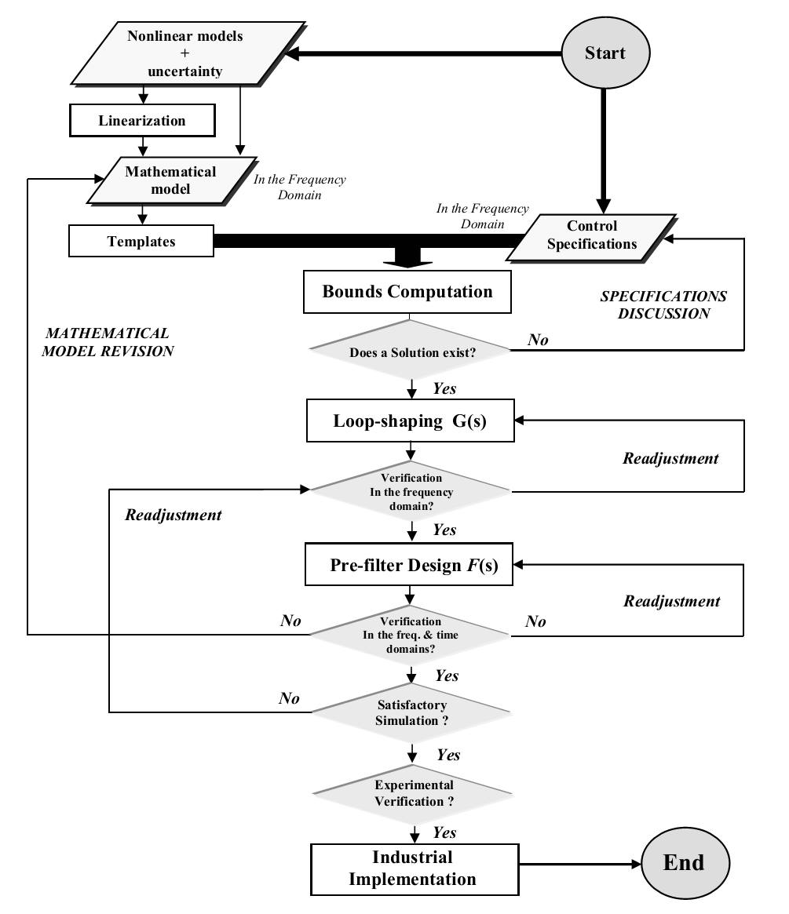
QFT
Procedure

Slide 22
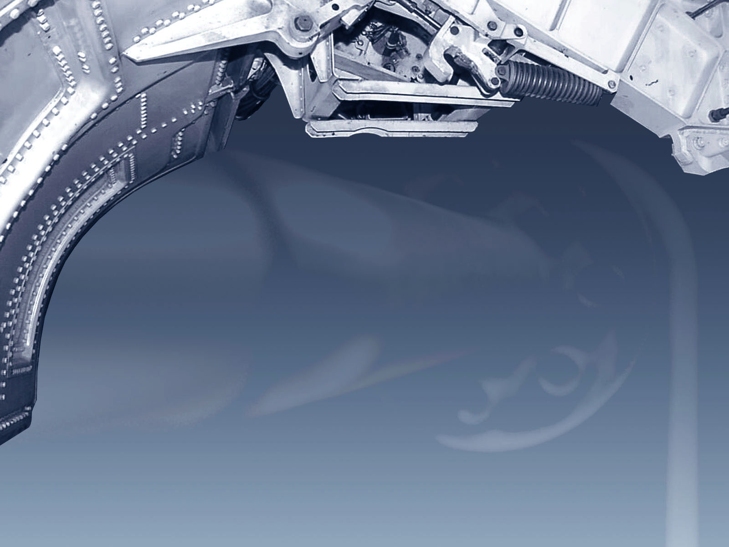
?
?
?
Any questions ??
Thanks !
?

Slide 23




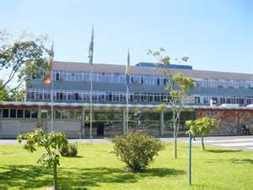

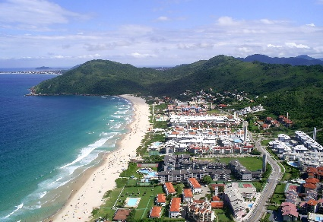
www.laship.ufsc.br/fpni2016

